Slide 1
The Eviction process
The most common cause for an eviction is
Non payment of rent
In many states, the only defense a tenant can offer for Non payment of rent is constructive eviction.
What is Constructive Eviction?

Slide 2
The landlord’s actions violated the tenant’s right under the Lease or failed to provide for the habitability of the unit or essential services, and the tenant has been forced to vacate the leased premises.
In other words the landlord did not fulfill their “Landlord Obligations”

Slide 3
Other grounds for evictions
Violation of the lease terms
Termination of employment
Violation of the lease clauses or addendums
Non payment of deposit or utilities
Criminal activity in the unit of any kind
Miss use of facilities
Pets in a “no pet unit”
Creating nuisance

Slide 4
The no cause eviction
Also called a retaliatory eviction
this comes about when the tenant claims that you are giving them an eviction notice because of retaliation due to..
Complaints made to you
Complaints made about you
Complaints made against the community

Slide 5
Do you need to give a resident the reason for the notice?
It is not necessary to give the tenant a reason for the eviction notice. It is, however necessary to give a reason to the attorney. And you must have all necessary documentation to defend your actions.

Slide 6
Disposition of abandoned personal property
Abandonment of unit
Post an abandonment notice
18 day notice
Make sure the unit has been abandoned
Try to reach the next to kin on application
You can also do a key check

Slide 7
Abandonment of personal property
If valued under $300.00 (trash)
If value over $300.00
    Consult your attorney
    Do a complete inventory
    Take pictures
    Witness may be required
    Notify resident by mail
    Store property for up to 12 months
    Publish a public auction date in newspaper
    Auction off the personal property

Slide 8
Abandoned vehicles
Post proper notice
Call local towing company
If you have contract with a towing company, they will take care of all notices for you

Slide 9
Rent collections after abandonment or Eviction
Be diligently in your collection efforts
Use a collection agency
Go to small claims court or housing court.

Slide 10
Prepare to appear in Small
Claims Court
Educate yourself
Adequate documentation
      Be organize
      Have photos
      Prepare your defense
      Provide proof of everything you are saying
      Make 3 copies of your files
        One for the Judge
        One for the defendant
        One for the plaintiff
Think as a judge

Slide 11
Remember the one with the better
Documentation WINS!!!!

Slide 12
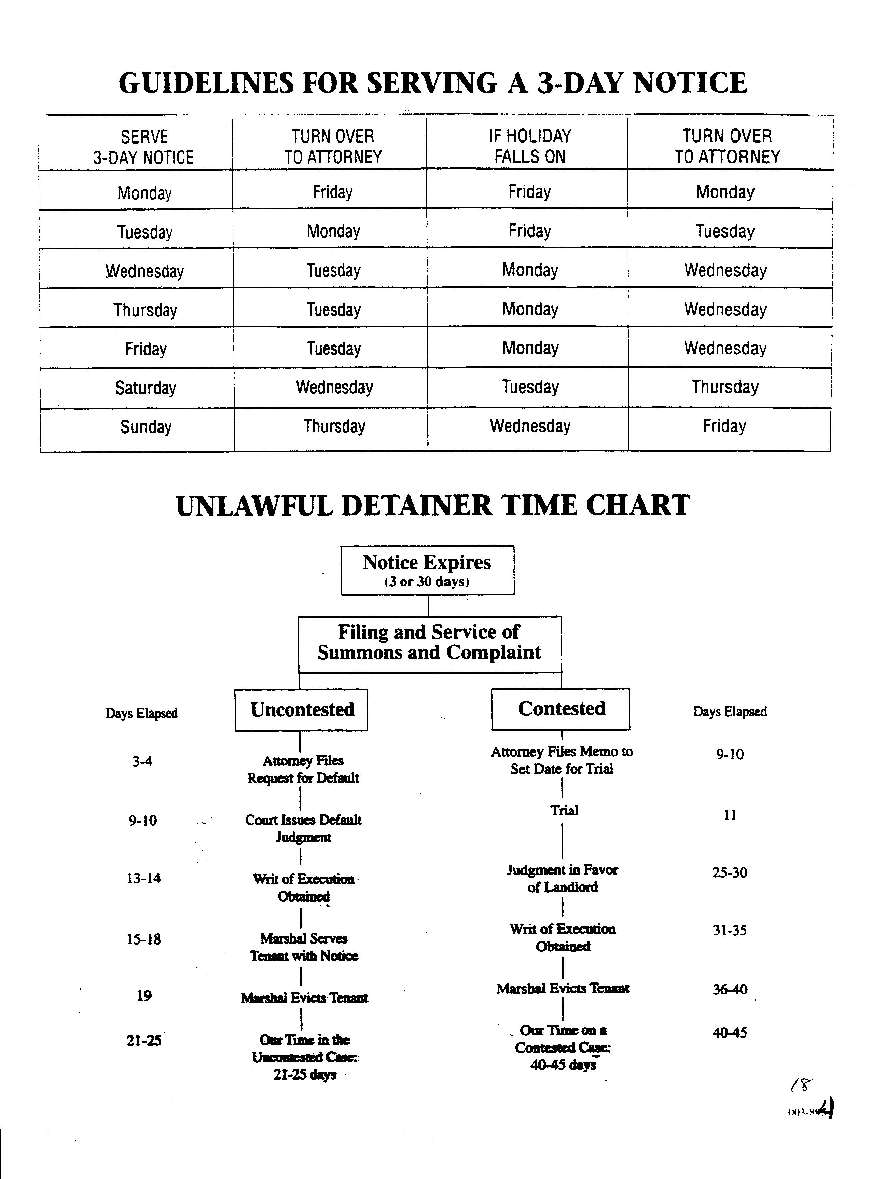

Slide 13
